Slide 1
Cohort Analysis using SQL and Tableau
SATHISH MANGATI
sathishmangati@gmail.com
+4917647660107

Slide 2
CONTENTS
My Task -- 3rd SLIDE
Understanding of data sets – 4th SLIDE
MySQL code and Output – 5 - 9 SLIDES
Tableau Visualizations – 10 - 15 SLIDES
My Answers for -- 16 – 18 SLIDES
Task Related Questions

Slide 3
My Task
To analyse customer retention, after their first purchase from wolt and also check month after month retention rate of first purchase users.
I have to create visualizations showing the monthly customer retention per product line to communicate the following:
Cohort based monthly retention for Retail product line
Cohort based monthly retention for Restaurant product line
I have to perform visualizations with my own selected charts and convey the best message.
I should solve this task using SQL, and give customer insights

Slide 4
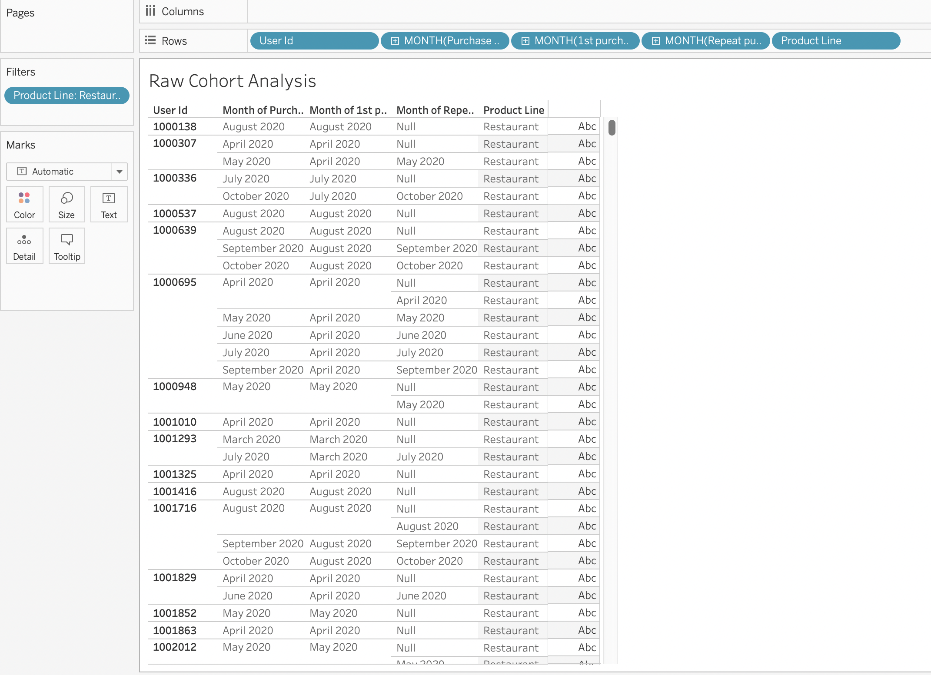



Understanding first purchase and purchase Data in Tableau:
This is a Raw cohort Analysis for both Restaurant and Retail store in Tableau.
Here user 1000307, first purchased in April 2020 from a restaurant and again purchased in May 2020. The user did a repeated purchase in May 2020 in the same month, but he did not purchase again in April, and it is denoted as NULL.
And user 1000695, first purchased in April 2020 and repeated his purchases for the following months he is a retention customer.
Also, user 1001293, first purchased in April 2020 and he did not repeat the purchase from wolt for 3 straight months, and again repeated the order in July 2020. He is a non-retention customer.
Here I can analyze how the customers are using wolt services after their first purchase. It gives detailed information on repetition months after their initial purchase.

Slide 5
SQL CODE
I mainly used MySQL Workbench to solve this task and I also checked and solved using Azure Data Studio and PostgreSQL for reference.
But for this task the code is written in MySQL Workbench Dialect.
I wrote SQL code to solve the task and visualized it in Tableau using SQL output results, which gave appropriate Visualization.
I have learned and practiced many big datasets and I applied my knowledge in this to achieve the goal. Point me if I have done any wrong, it helps me improve my skills.
I have attached SQL code with Zip file for reference. Please check

Slide 6
CONTINUE..
The SQL code has 4 sections, which I mentioned in the code with the section number.
I did step by step approach to achieving the final result. And I want to show my skills in SQL to you so I made it like that.
I used the “with” clause to store the results and manipulate them later.
I am using MacBook, so I had many issues with data uploading and some Query functions but finally I made good output.
According to me, I put all my skills and time to get appropriate and best results to know customer retention.

Slide 7
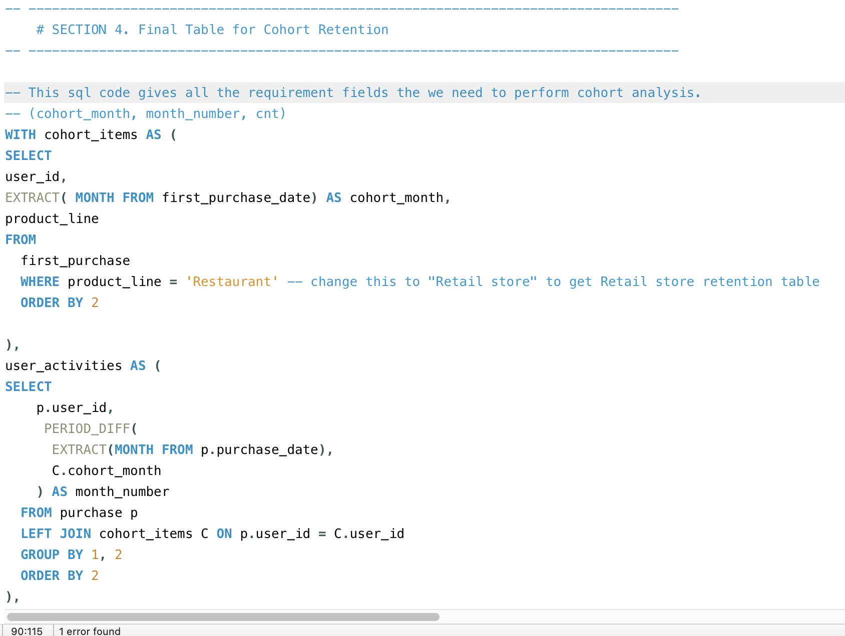

Slide 8
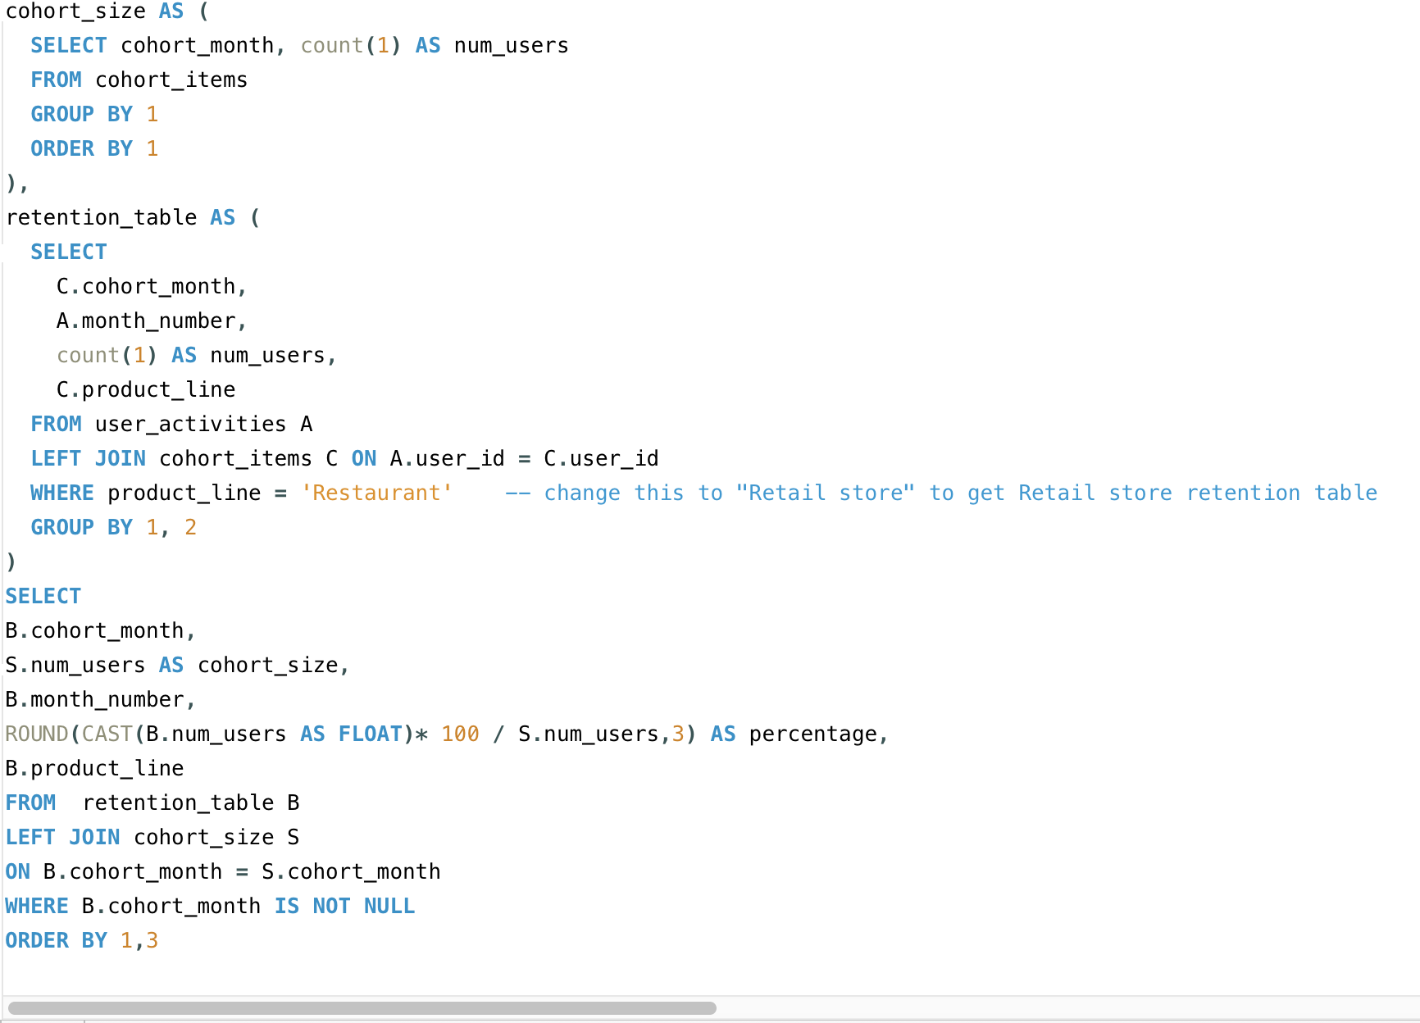

Slide 9
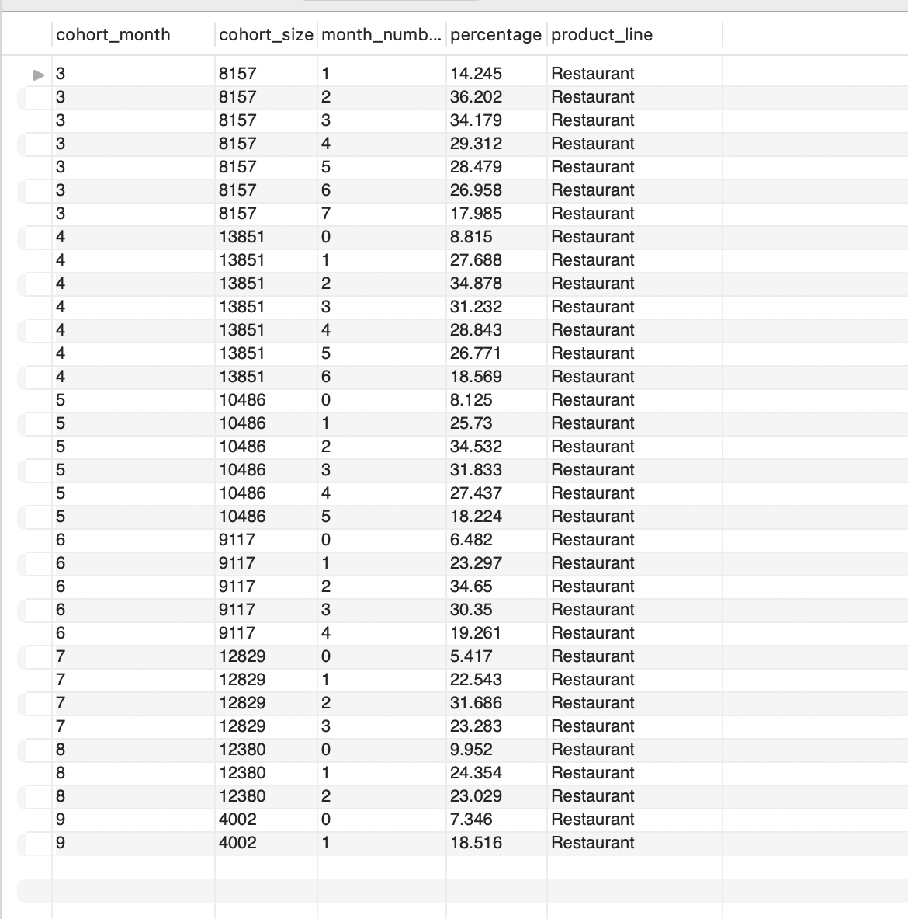
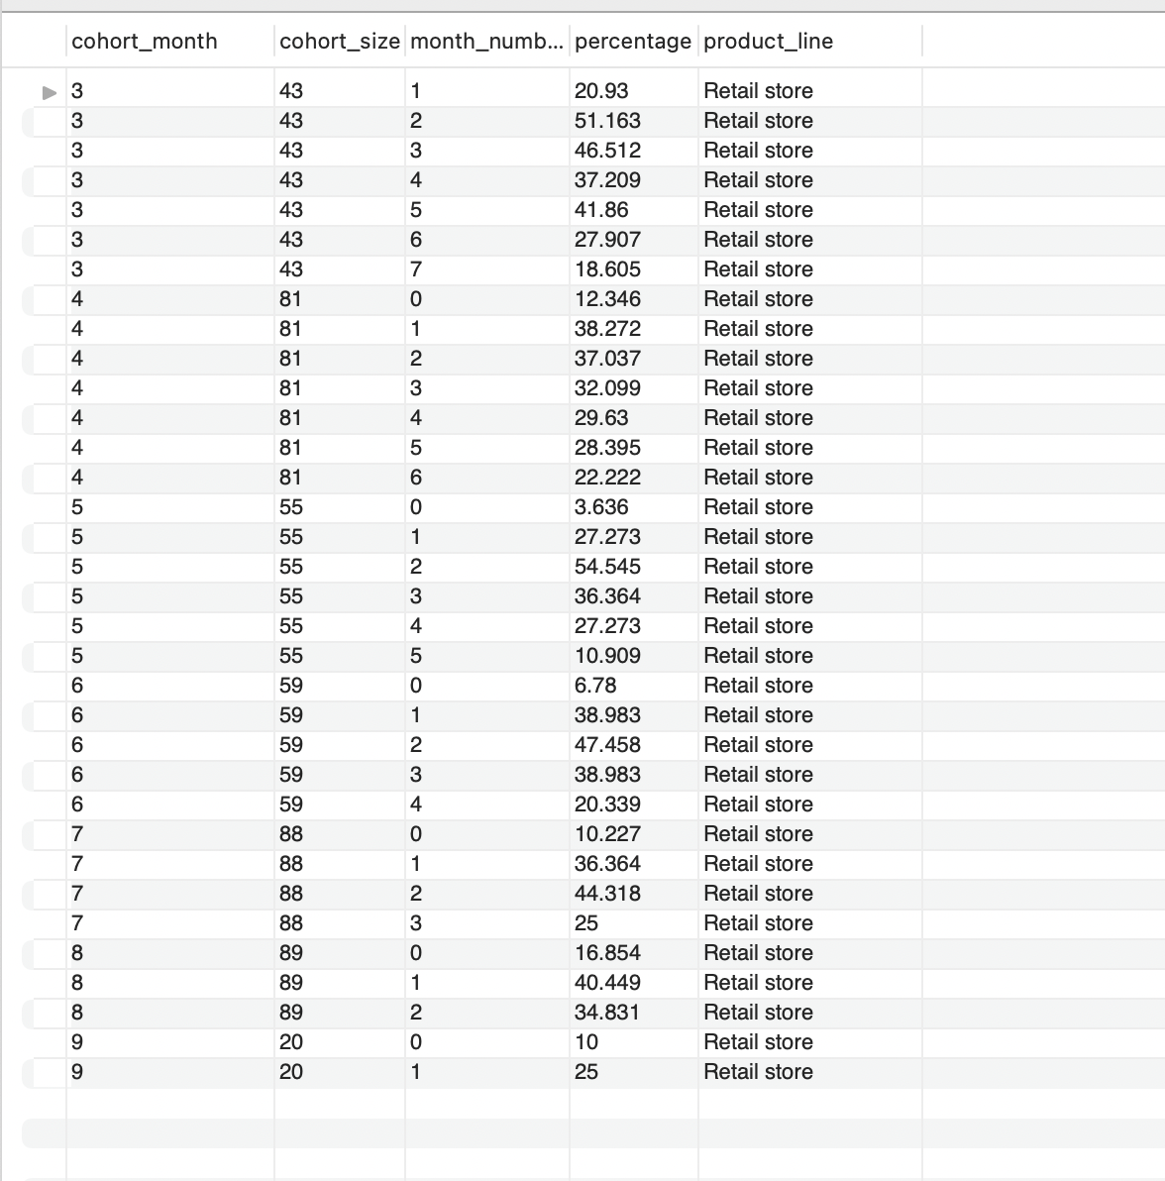
Restaurant Cohort Analysis output
Retail store Cohort Analysis output

Slide 10
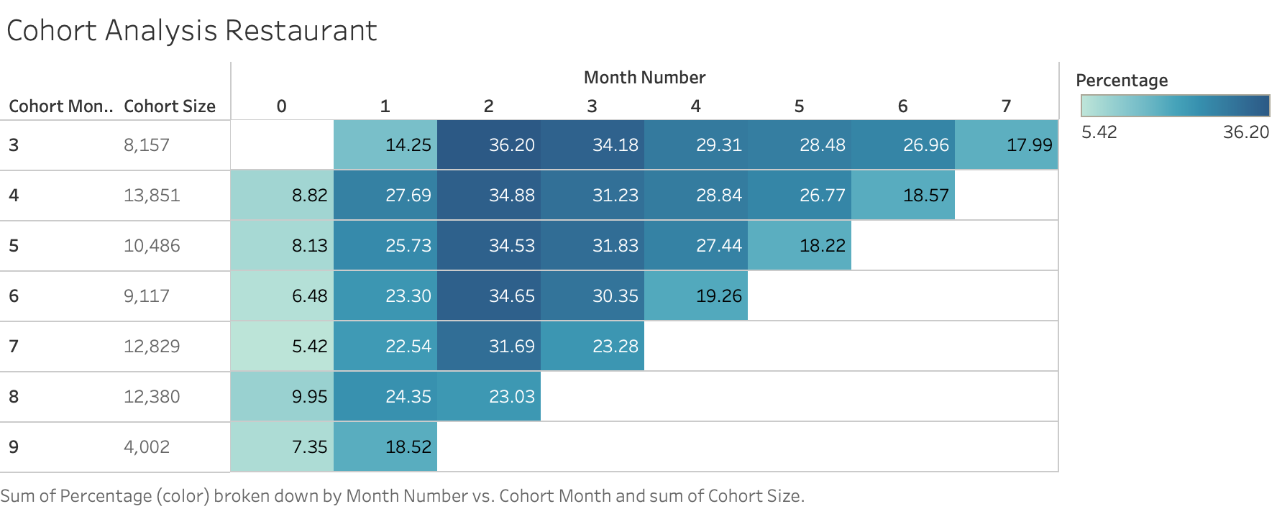
Above cohort analysis for users ordering from Restaurant, with this final view, you can track customer return purchases from a restaurant. For instance, you can see that – for customers acquired in 2020 March(Cohort month 3) with null initially but made 14.25% in their first purchase and 36.20% in the third purchase after 2 months(which is the highest user retention month). While for customers acquired in 2020 July(Cohort month 7), 5.42% made their first purchase and in 2nd month acquired 22.54% of the customers, it fitted highest in third purchase with 34.65%.
We can see that the customer acquisition started with a small percentage and many people started to repeat purchases from wolt but it lost more customers by the end of the year which is a bad sign of customer retention.
The sum of users in all months is very good and shows good retention except September, which has the least retention rate.

Slide 11
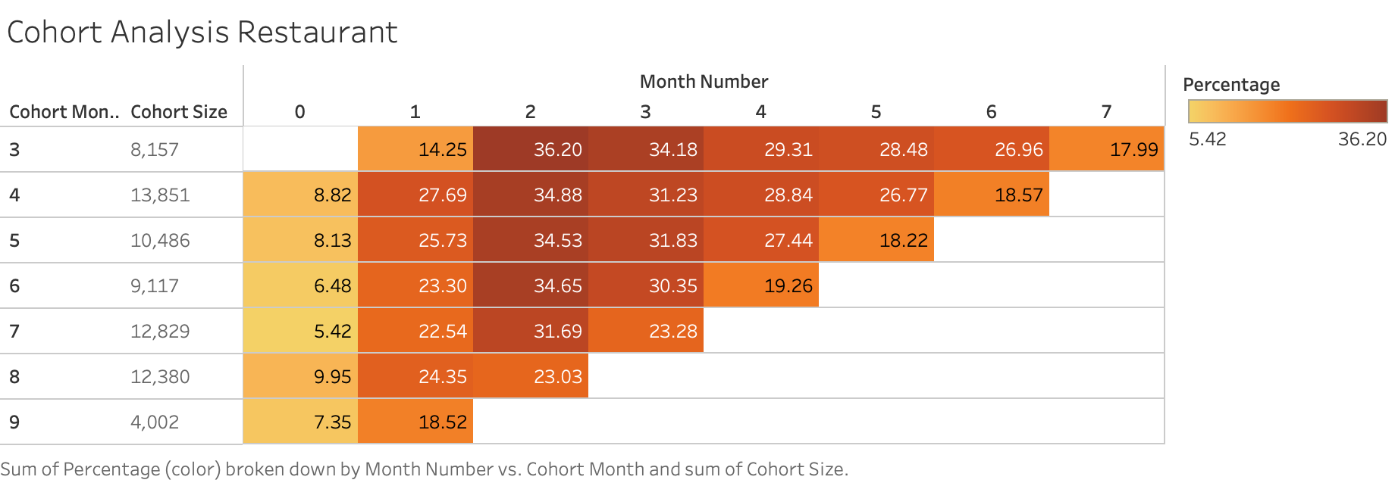
This is Restaurant user retention in percentile(%)
For each cohort, we show the population (how many people) in that cohort in the second column
Here it is a very clear view, the more dark orange is the highest user retention where as the lighter orange colour is the least user retention percentage.

Slide 12
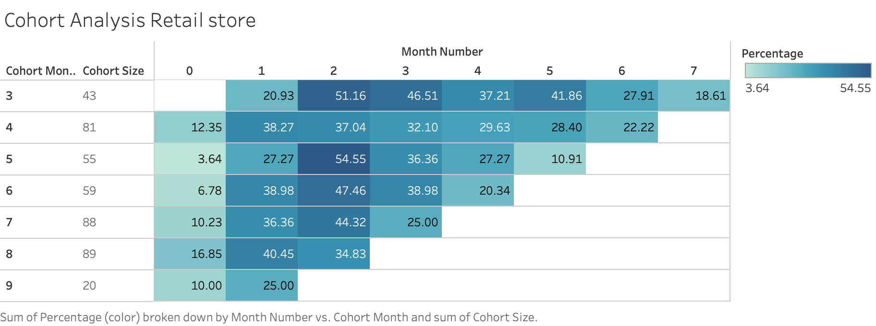
Above cohort analysis for users ordering from Retail Store, with this final view, you can track customer return purchases from Retail store. For instance, you can see that – for customers acquired in 2020 March(Cohort month 3) with null initially but made 20.93% in their first purchase and 51.16% in the third purchase after 2 months(which is the highest user retention month). While for customers acquired in 2020 July(Cohort month 7), 10.23% made their first purchase. In 2nd month acquired 36.36% of the customers and it fitted the highest retention in the third purchase with 44.32%.
We can see that the customer acquisition started with a small percentage and many people started to repeat purchases from wolt but it Retained a good amount of users by the end of the year which is a good sign of customer retention.
The sum of users in all months is almost giving a good retention rate. This is because users ordering through the retail store is minimal in the whole year.

Slide 13
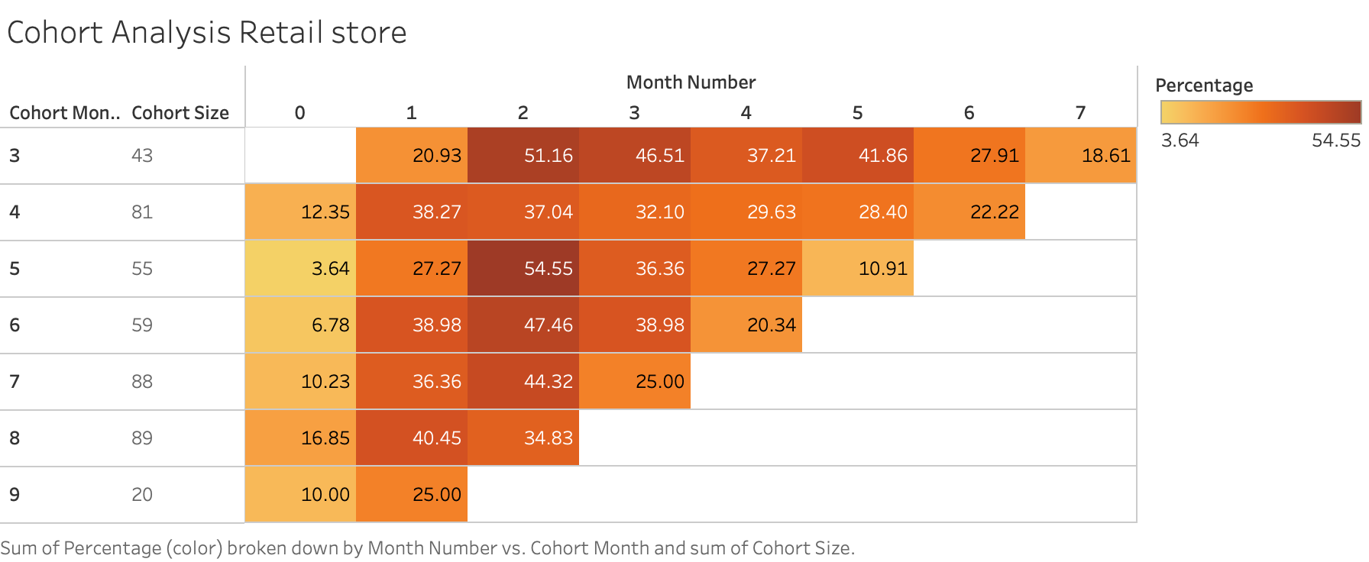
This is Retail store user retention in (%)
For each cohort, we show the population (how many people) in that cohort in the second column
Here it is a very clear view, the more dark orange is the highest user retention where as the lighter orange colour is the least user retention percentage.

Slide 14
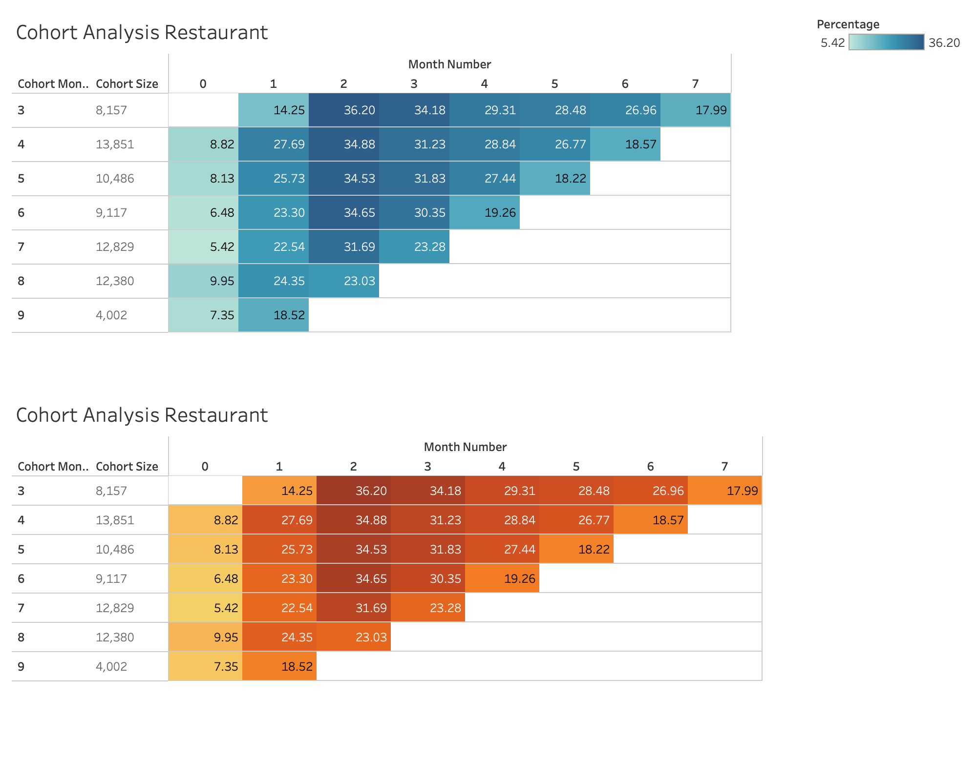

Slide 15
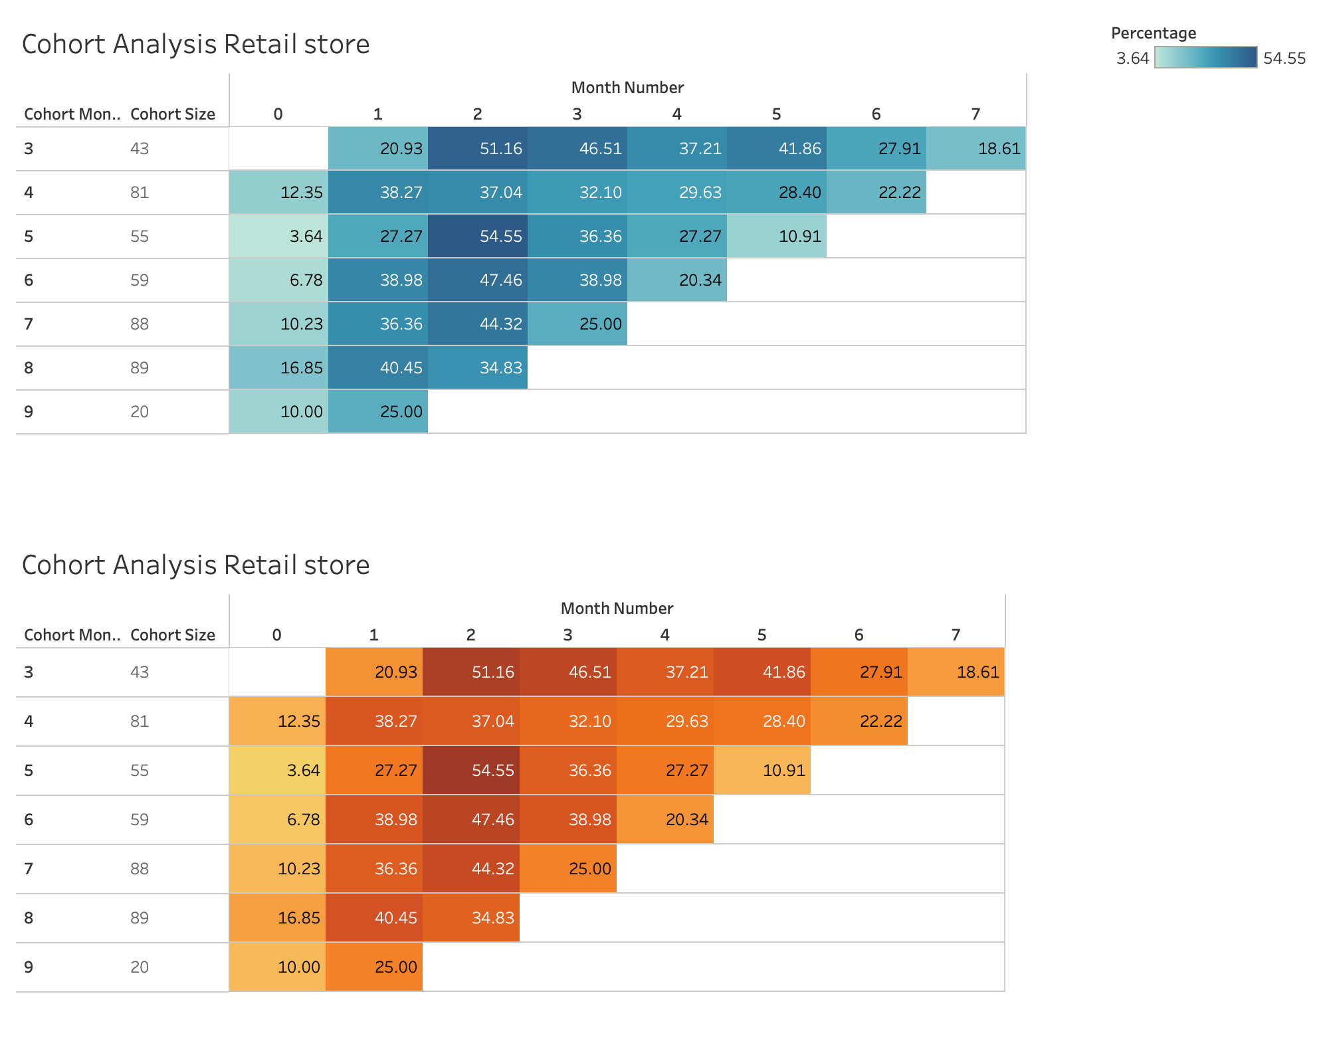

Slide 16
MY ANSWERS
1. What assumptions about the data did you make when creating your retention charts?
I have done much research into the data sets, I tried different SQL queries to get data set for visualization and I came up with an assumption to use the Subquery method using WITH clause. It is same as temp tables or CTE.
I created cohort groups for the first purchase and stored them as cohort_month using with clause and also grouped the user_activity(this could simply view the page, or as specific as making a purchase) and remaining calculations required to perform SQL queries to get cohort table.
To Visualize the user retention I took SQL output data and did not use any calculated fields in Tableau to get the desired visualization.

Slide 17
2. Did you encounter any problems in the data?
No, because the datasets are precise and efficient. We have all the required fields to calculate useful queries.
I think some data is missing for March in the first purchase users, where I got null for this area. The starting March month shows Null value (Check the cohort analysis above to get my point).
The date column is in sting format, it throws an error while uploading the data into MySQL. I did change the string format to Date using Excel.

Slide 18
3. Which additional data sources or business information do you think could be used to improve your solution?
Yes, I assume to have more data for calculating exact values to analyze customer behaviour and perform cohort analysis with more insights.
The data like purchasing amount, order time, offers and gender can give more insights to perform good analysis to improve business.
Mainly if a numerical section like the above data sources is given, I can do Cohort Analysis in a very fast manner.

